Slide 1
Co-dfns Report
Dyalog ‘22
Aaron Hsu - aaron@dyalog.com

Slide 2
Why Co-dfns?

Slide 3
Make APL more scalable/accessible

Slide 4
Parallelism

Slide 5
Domains

Slide 6
How to APL
+
Where to APL

Slide 7
How?

Slide 8
Use APL everywhere

Slide 9
Data-parallel
tree processing

Slide 10
Data-parallel
Parser + Code-generation

Slide 11
Much faster (≥62×) Error handling Ambiguous APL
Type inference Language features Input types

Slide 12
Public Parser API

Slide 13
codfns.PS':Namespace' 'X←5' 'F←{Y←3 ⋄ X-⍺+⍵×Y}' ':EndNamespace’
F0:4[]┬B1:0[←]┬V1:0[X]
│ └A1:0[5]
└B2:0[←]┬V2:0[F]
└C2:0[]┬F2:4[]┬B1:0[←]┬V1:0[Y]
│ │ └A1:0[3]
│ └E2:0[]┬V1:1[X]
│ ├P2:3[-]
│ └E2:0[]┬P1:4[⍺]
│ ├P2:3[+]
│ └E2:0[]┬P1:4[⍵]
│ ├P2:3[×]
│ └V1:0[Y]
└V1:0[X]

Slide 14
codfns.PS '(2=+⌿0=X∘.|X)⌿X←⍳20'
E2:0[]┬E2:0[]┬A1:0[2]
│ ├P2:3[=]
│ └E1:0[]┬O2:3[]┬P2:3[+]
│ │ └P3:3[⌿]
│ └E2:0[]┬A1:0[0]
│ ├P2:3[=]
│ └E2:0[]┬V1:0[X]
│ ├O2:3[]┬P2:3[|]
│ │ └P3:3[∘.]
│ └V1:0[X]
├P2:3[⌿]
└B1:0[←]┬V1:0[X]
└E1:0[]┬P2:3[⍳]
└A1:0[20]

Slide 15
LBL (dwh pp3) p
LBL (dwv pp3) p

Slide 16
(d t k n lx pos end)(xn xt)sym IN

Slide 17
codfns.PS':Namespace' 'F←{(⍺+⍵}' ':EndNamespace'
SYNTAX ERROR: MISMATCHED PARENS/BRACKETS
[2] F←{(⍺+⍵}
▔▔▔▔
codfns.PS ':Namespace' 'F←{(⍺⍺ ⍵)[)]}' ':EndNamespa'
SYNTAX ERROR: UNRECOGNIZED KEYWORD(S)
[3] :EndNamespa
▔▔▔▔▔▔▔▔▔▔▔
codfns.PS ':Namespace' 'F←{[⍺⍺ ⍵]}' ':EndNamespace'
SYNTAX ERROR: BRACKET SYNTAX REQUIRES FUNCTION OR ARRAY TO ITS LEFT
[2] F←{[⍺⍺ ⍵]}
▔▔▔▔▔▔

Slide 18
Static Analysis

Slide 19
“Text Processing in APL”

Slide 20
Data-parallel code gen?

Slide 21
Where?

Slide 22
GPUs

Slide 23
ML + HPC

Slide 24
U-net Neural Network

Slide 25
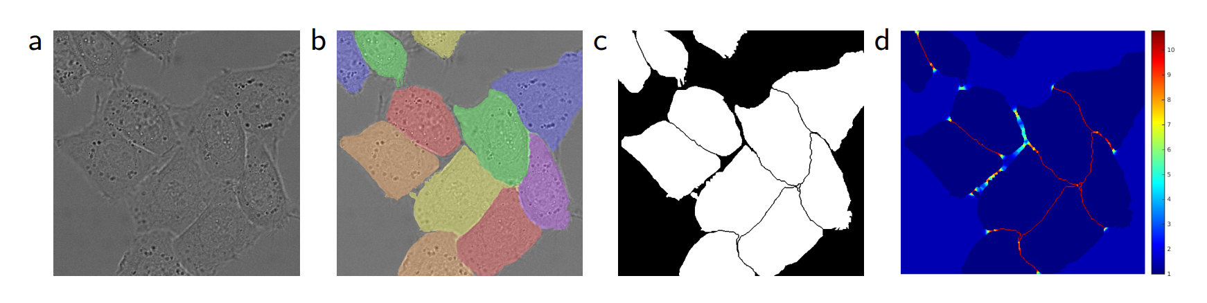
(Ronneberger, Fischer, and Brox 2015)

Slide 26
0 2 1 3 4⍉⍵+.×⍺

Slide 27
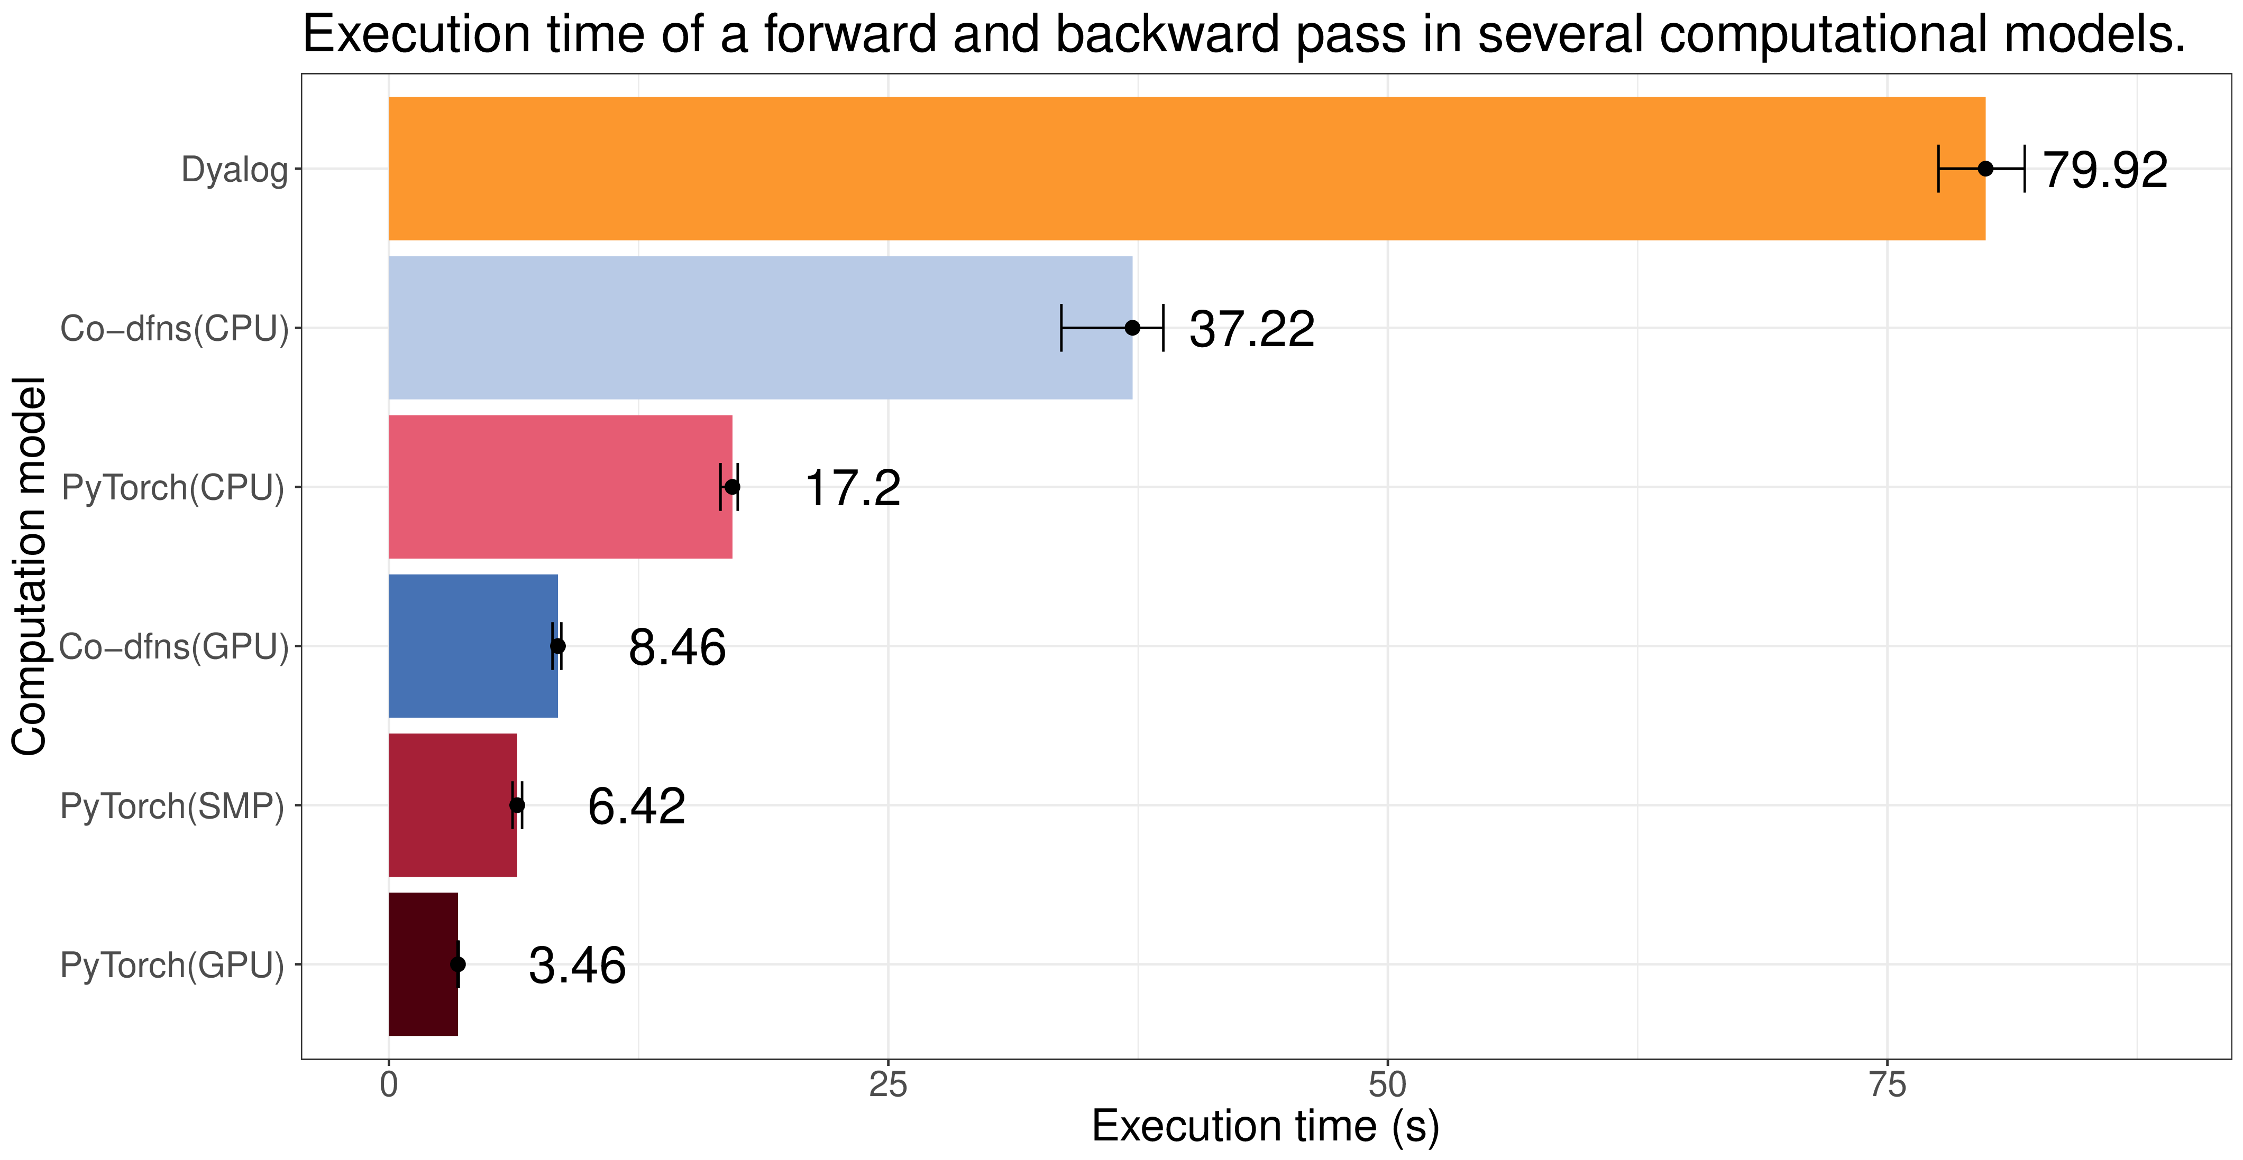

Slide 28
New platforms
=
New applications

Slide 29
Portable Code Generation

Slide 30
Separate runtime distributable

Slide 31
Runtime implemented in APL

Slide 32
Retargeting
code gen + kernel
retargets the runtime

Slide 33
Flexibility

Slide 34
Extensibility

Slide 35
Low-overhead foreign function interface

Slide 36
‘foreign’⌶

Slide 37
First-class namespace objects

Slide 38
Integrate with other software environments

Slide 39
Javascript/WASM Python Java/C# Scheme/Lisp Custom Hardware

Slide 40
Native Interface + DWA

Slide 41
int
my_func(ARR **, ARR *, ARR *);
int
my_func_dwa(DWA *, DWA *, DWA*);

Slide 42
Optimized Runtimes

Slide 43
CPU vectors Energy efficiency
Space efficiency
Scalar-optimized

Slide 44
CPU + GPU
Data buffers

Slide 45
What to expect…

Slide 46
New runtime may
run slower initially

Slide 47
Fuller coverage of APL primitives

Slide 48
Characters
Mixed Arrays
Complex Numbers
Noble Arrays+
Nesting

Slide 49
Add the big
“missing language features”

Slide 50
Trad-fns
Dynamic Scope
Control Structures
Branching
Error trapping/guards
Selective assignment
Execute/ambiguous values
Exporting user-defined operators
Namespaces

Slide 51
Lexical/Dynamic Scoping
“done right”

Slide 52
Closures

Slide 53
Tracing and Debugging

Slide 54
Begin retargeting to new platforms

Slide 55
Publish/document new innovations and techniques

Slide 56
New work is driven by project interest,
especially code.

Slide 57
Please send code!
Broken or working

Slide 58
Thank you.

